Slide 1

ESCAPE
A new way to explore.
CSCI - 548 project
bit. l y / Es cape Explorer
Chinmaya Gautam Arpit Nigam

Slide 2
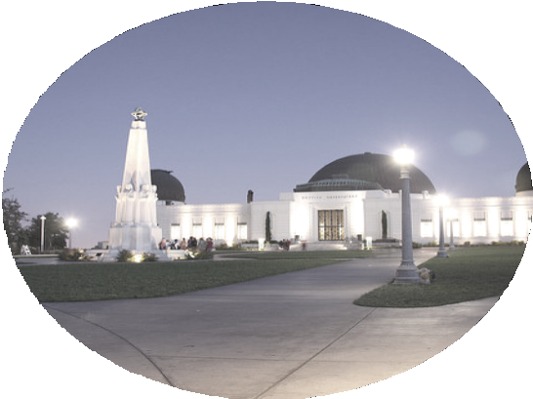
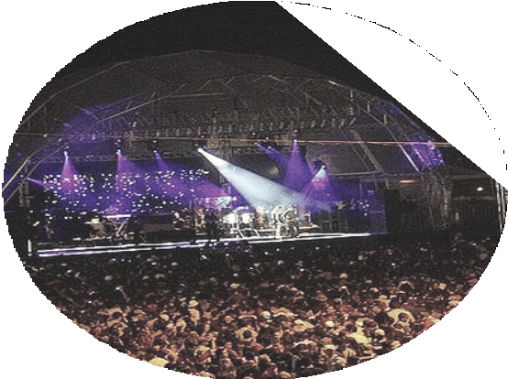

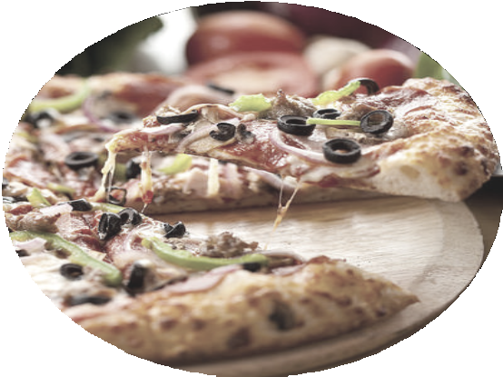
c t e s c a p e .
F i n d y o u p e r f e
P A R T I C I P A T E
P L A C E S
E V E N T S
M O V I E S
F O O D

Slide 3

E X P L O R E P L A C E S
Source: dbpedia.org
Method: Python SPARQLWrapper Input: City and State
Output: Name, Address, Description & image

Slide 4
E X P L O R E P L A C E S
We used the SPARQL Endpoint Interface to Python to query visitor attractions given a city and a state by dynamically forming a url of form http://dbpedia.org/resource/Category:Visitor
_attractions_in_<city>,_<state>
we query for rdfs:label, rdfs:comment, foaf:description and dbo:address

Slide 5
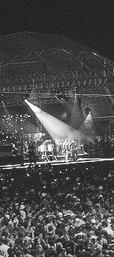
E X P L O R E E V E N T S
Source: eventbrite Method: Eventbrite API Input: City
Output: Name, Address, Logo and Eventbrite URL

Slide 6
E X P L O R E E V E N T S
We use the Eventbrite API to fetch data about events taking place given a city and store it as a CSV.

Slide 7

E X P L O R E M O V I E S
Source: Fandango.com Method: Wrapper Input: City, State
Output: Theater information and movie times

Slide 8

E X P L O R E M O V I E S
We python mechanize package to retrieve data from fandango given the city and the state based on the url template: http://www.fandango.com/<city>_<state>_m ovietimes
Then we use beautifulsoup to extract required data based on div tags and their class attributes

Slide 9

E X P L O R E F O O D
Sources: Zomato and Factual Method: APIs, Record Linkage Input: City and State
Output: Name, Address, Rating, Cuisines, Telephone, Image

Slide 10
E X P L O R E F O O D
We use the respective developer APIs to extract data and store them as CSVs, we then given the two datasets we use blocking based on zipcode and jaro­ winkler similarity on names to associate records of the two datasets to create our final restaurant dataset.

Slide 11

C I T Y &
Z I P C O D E
We used the data from U.S. Postal services to collect information about zipcodes, cities, and corresponding states. User can either provide city or can provide zip code.
By Default we are picking user current location

Slide 12

D A T A
C L E A N I N G
Google Refine
Addresses of most places in data were in a single string including city, state, zip code.
Separated them into separate fields. Removed all inaccurate records.

Slide 13
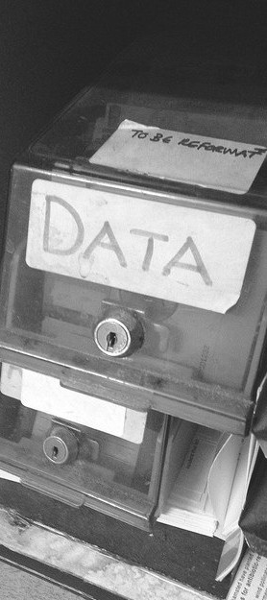
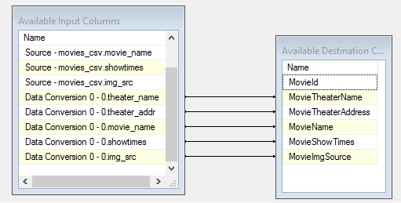
ETL tool ­ Microsoft SSIS Source ­ Flat files (csv's)
Destination ­ Microsoft Azure SQL
E T L

Slide 14
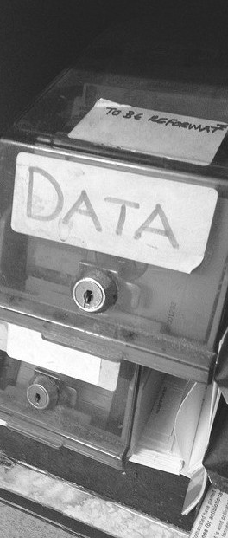
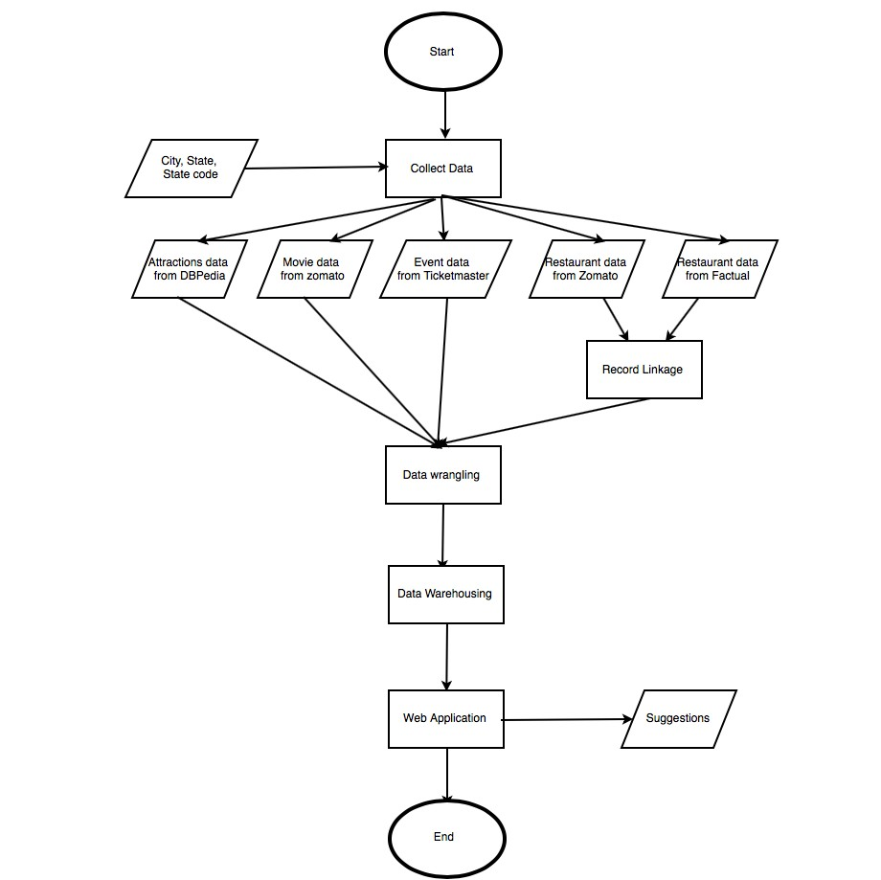
F L O W
F L O W

Slide 15

E V A L U A T I O N
Places:
Records retrieved = 26 Recall = 0.96
Events:
Records retrieved = 50 Recall = 0.94
Movies:
Records retrieved = 50 Recall = 1.0
Restaurants:
Records retrieved = 600 Recall = 1.0
Record Linkage:
Identified pairs: 49 pairs found by code: 47 Recall = 0.96
Precision = 1.0

Slide 16
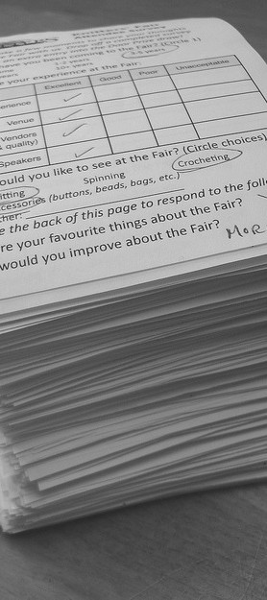
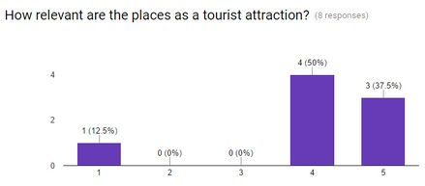
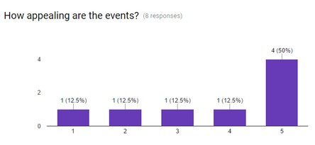
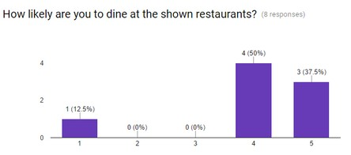
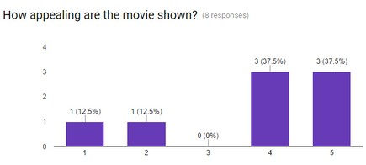
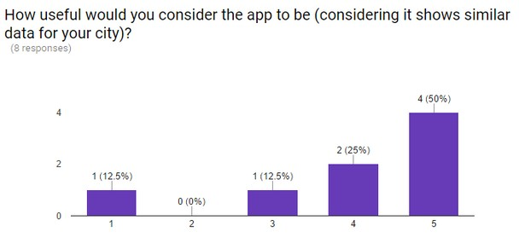
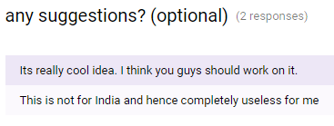
^{S}W^{U}ith D^{R}emo^{V}Ap^{E}plic^{Y}atio^{S}n on azure.

Slide 17
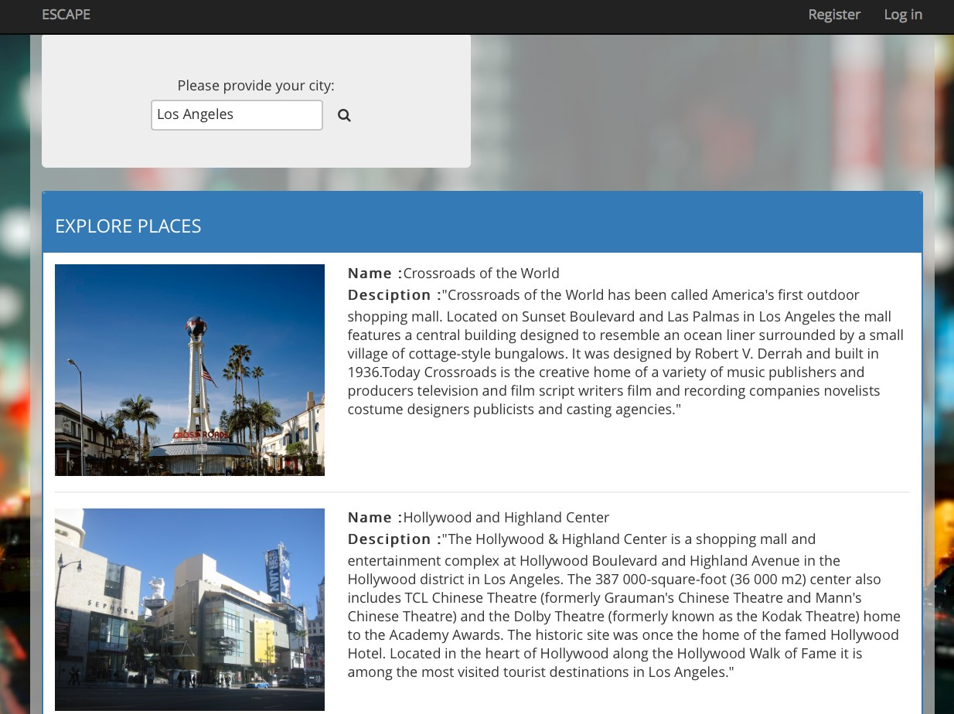
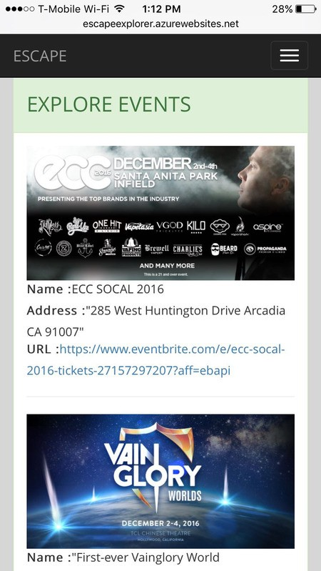
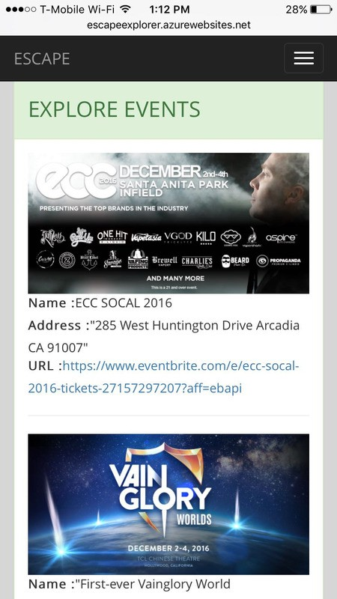
D E M O
With Demo Application on azure.

Slide 18
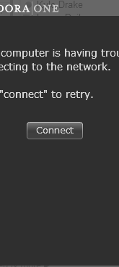
C H A L L E N G E S
Broken URLs and redirects Missing data
Unicode strings API restrictions

Slide 19

F U T U R E
Use more resources to collect even more data. ­ Ticketmaster, atom movies tripadvisor etc.
Remove restriction of country.

Slide 20



Happy Exploring!
Arpit Nigam
Chinmaya Gautam
arpitnig@usc.edu
github.com/nigamarpit
cgautam@usc.edu
github.com/chinmaya-gautam
*All images used in this presentation have been procured from flickr and are under CC0 license.

